Slide 1



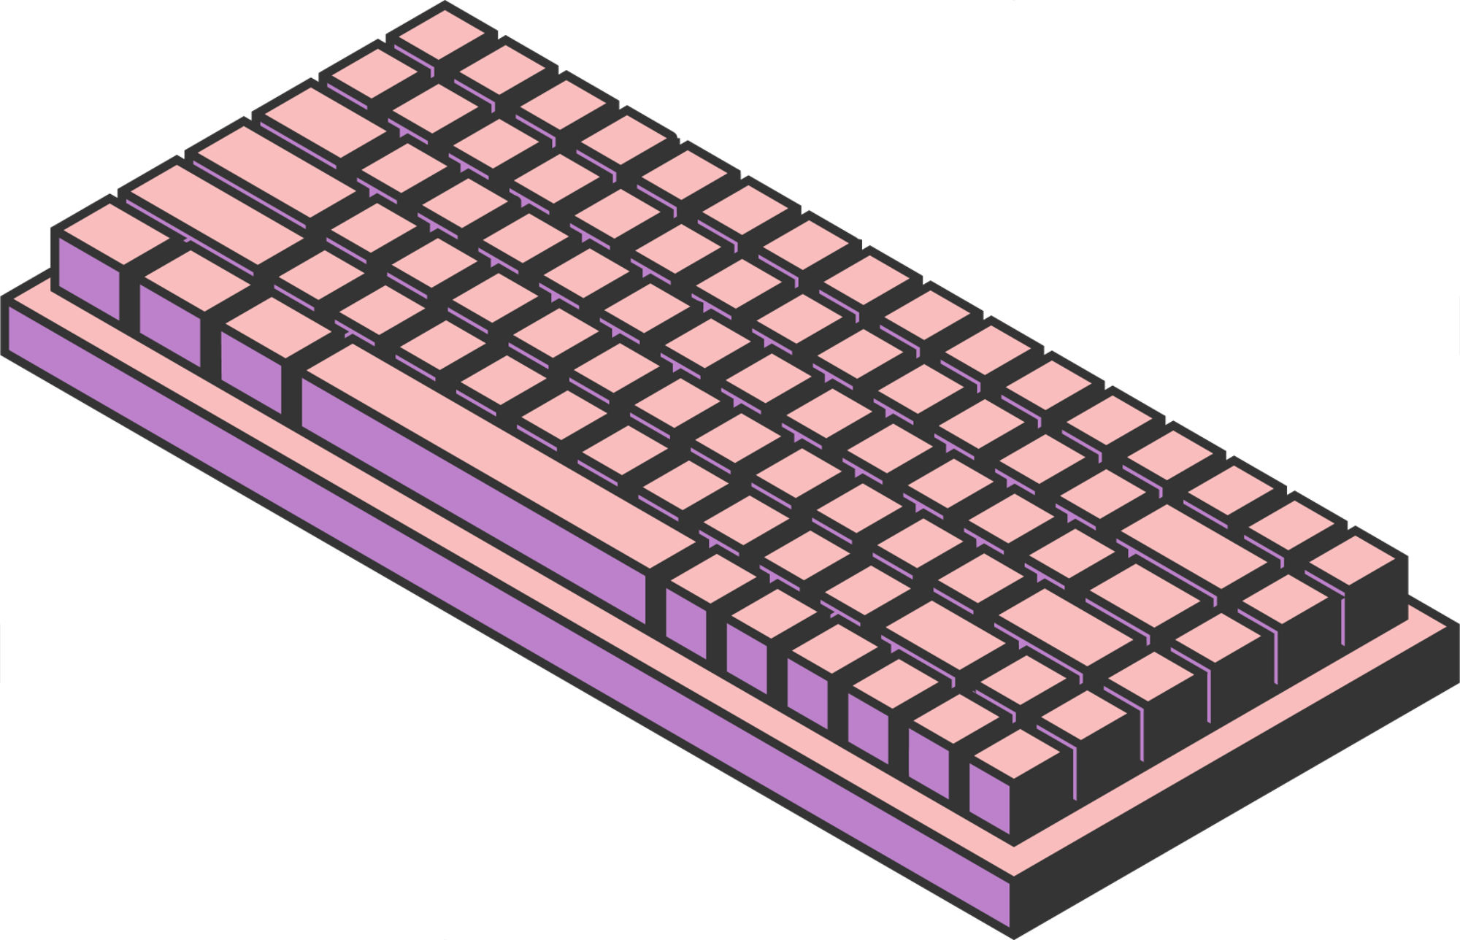
COMP S460F
Presentation
Topic: Text Classification of Lyrics Using SVM
Group 1: Lee Ho Ming 12883890
Li Wing On 12886461
Cheng Kwing To 12889278
Kam Sum Kai 12886203
1

Slide 2

INTRODUCTION
Classifying songs according to the lyrics
Use Natural Language Processing and Support Vector Machine
Four main stages
~ Data collection
~ Data preparation
~ Model training
~ Model evaluation
2

Slide 3


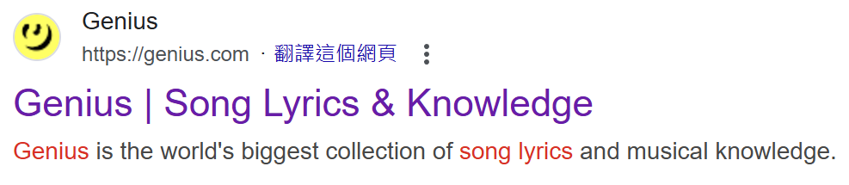
The idea from … ?
Provided GitHub Sample
Songs
Lyrics
3

Slide 4


Mathematical formulation
- TF-IDF Vectorization
- Feature Scaling
- Support Vector Machine (SVM) Classification Standardization
- Confusion Matrix and Evaluation Metrics
4

Slide 5

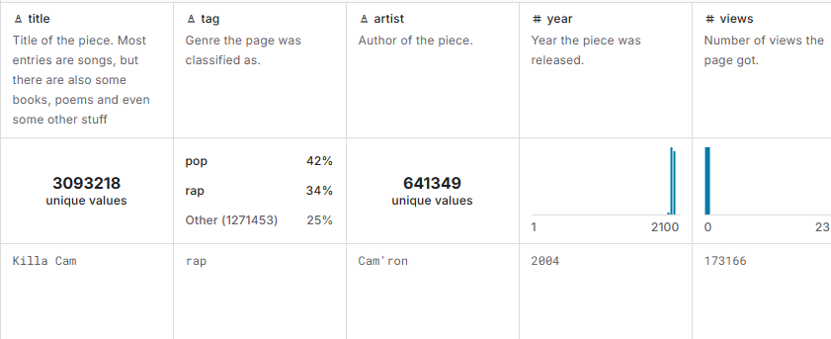

Data collection
-Download a dataset containing 5 million songs on Kaggle
-songs are sorted by 'pop', 'rock', 'country', 'rap', 'R&B', 'miscellaneous'
5

Slide 6

Data preparation
1. Data sampling
- select three types of songs instead of six since songs are unevenly distributed
- ignore some minor information of the song e.g. released year and author
2. Data cleaning
-convert all lyrics into lowercase
-handle short form back to normal form e.g. 'don't' ' do not'
-remove punctuation, numbers and special characters
6

Slide 7
Data preparation
3. Feature extraction and selection
-convert cleaned lyrics into numerical feature vectors
-examples of parameters:
-'min_df': ignore terms that appear less than certain no. of documents
-'max_df': ignore terms that appear too many times
-apply chi-squared test to select the top 20000 features
7

Slide 8


Model Training
-Use GridSearchCV with k-fold cross-validation for training
-set k = 5, divides the data into 5 folds
-randomly shuffles the data before splitting
-maintain same proportion of samples for each class
-find the best hyperparameters for the SVM classifier
8

Slide 9
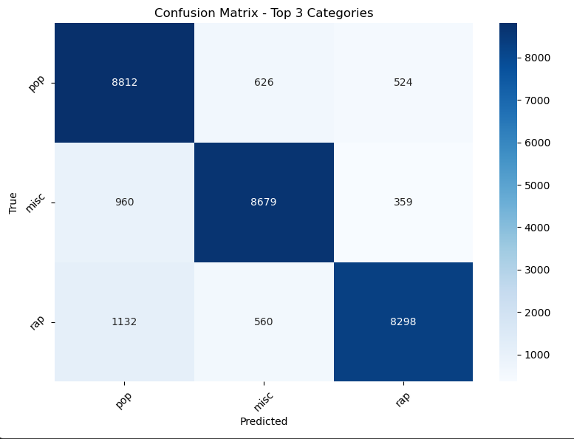
Model Evaluation
-accuracy will be shown after testing
-confusion matrix including precision, recall and F1 score are
available for overseeing whole testing process(how the model
perform to each type of songs)
9

Slide 10
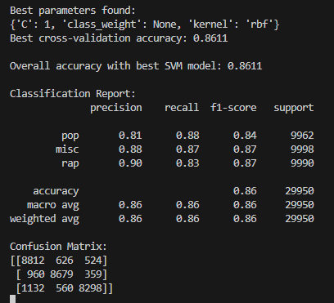
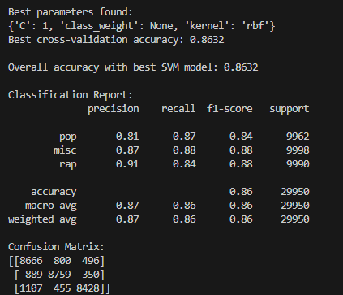
Result Analysis
sample for each category=10000
k-fold cross validation (5)
min_df =5
rbf kernel
lower accuracy
sample for each category=10000
k-fold cross validation (5)
min_df =100
rbf kernel
higher accuracy
10

Slide 11



Conclusion
-the SVM model performed well in lyrics classification task with 86.32% of accuracy
-in three-way classification, rbf kernel works better than linear kernel
In showing non-linear data relationships
-high precision in all three category: Pop(0.81), Miscellaneous(0.88),
Rap(0.90)
-balanced sampling (10,000 songs per category)
11

Slide 12
Limitations
-Dataset size (9GB, 5M songs) too large for complete model training
-17% misclassification rate for rap lyrics
-only 3 genres used (pop, rap, miscellaneous)
-high memory requirements for lyrics analysis and computational resource constraints
12

Slide 13
Future Work
Technical Enhancements:
-implement BERT or transformer models
-develop more efficient data processing pipeline
-enable more dataset utilization
Functional Improvements:
-expand to handle all six original categories
-maintain accuracy with increased genre coverage
-implement streaming data processing for better scalability
13

Slide 14
Work Distribution
Lee Ho Ming Andy | Design the flow of the program
Kam Sum Kai Lydia | Data collection and data selection
Li Wing On Alex | Model training and evaluation
Cheng Kwing To Panda | Data preparation and parameter tunning
14

Slide 15



THANK YOU
15

Slide 16
Q & A Section
16

